Slide 1
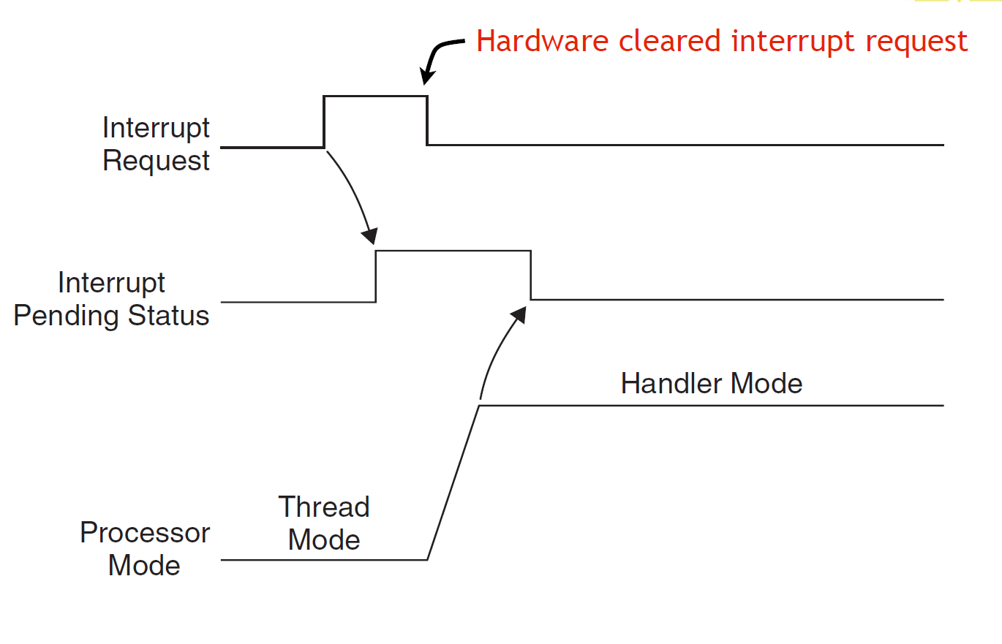
EECS 373
Design of Microprocessor-Based Systems
Prabal Dutta
University of Michigan
Lecture 7: Exceptions and Interrupts
September 27, 2011

Slide 2
Interrupts
Merriam-Webster:
  “to break the uniformity or continuity of”
Informs a program of some external events
Breaks execution flow
Key questions:
Where do interrupts come from?
How do we save state for later continuation?
How can we ignore interrupts?
How can we prioritize interrupts?
How can we share interrupts?

Slide 3
I/O Data Transfer
Two key questions to determine how data is transferred to/from a non-trivial I/O device:
  How does the CPU know when data is available?
    Polling
    Interrupts
  How is data transferred into and out of the device?
    Programmed I/O
    Direct Memory Access (DMA)

Slide 4
Interrupts
Interrupt (a.k.a. exception or trap):
An event that causes the CPU to stop executing the current program and begin executing a special piece of code called an interrupt handler or interrupt service routine (ISR). Typically, the ISR does some work and then resumes the interrupted program.
Interrupts are really glorified procedure calls, except that they:
  can occur between any two instructions
  are transparent to the running program (usually)
  are not explicitly requested by the program (typically)
  call a procedure at an address determined by the type of interrupt, not the program

Slide 5
Two basic types of interrupts
(1/2)
Those caused by an instruction
  Examples:
    TLB miss
    Illegal/unimplemented instruction
    div by 0
  Names:
    Trap, exception

Slide 6
Two basic types of interrupts
(2/2)
Those caused by the external world
  External device
  Reset button
  Timer expires
  Power failure
  System error
Names:
  interrupt, external interrupt

Slide 7
How it works
Something tells the processor core there is an interrupt
Core transfers control to code that needs to be executed
Said code “returns” to old program
Much harder than it looks.
  Why?

Slide 8
… is in the details
How do you figure out where to branch to?
How to you ensure that you can get back to where you started?
Don’t we have a pipeline? What about partially executed instructions?
What if we get an interrupt while we are processing our interrupt?
What if we are in a “critical section?”

Slide 9
Where
If you know what caused the interrupt then you want to jump to the code that handles that interrupt.
  If you number the possible interrupt cases, and an interrupt comes in, you can just branch to a location, using that number as an offset (this is a branch table)
  If you don’t have the number, you need to poll all possible sources of the interrupt to see who caused it.
    Then you branch to the right code

Slide 10
Get back to where you once belonged
Need to store the return address somewhere.
  Stack might be a scary place.
    That would involve a load/store and might cause an interrupt (page fault)!
  So a dedicated register seems like a good choice
    But that might cause problems later…

Slide 11
Snazzy architectures
A modern processor has many (often 50+) instructions in-flight at once.
  What do we do with them?
Drain the pipeline?
  What if one of them causes an exception?
Punt all that work
  Slows us down
What if the instruction that caused the exception was executed before some other instruction?
  What if that other instruction caused an interrupt?

Slide 12
Nested interrupts
If we get one interrupt while handling another what to do?
  Just handle it
    But what about that dedicated register?
    What if I’m doing something that can’t be stopped?
  Ignore it
    But what if it is important?
  Prioritize
    Take those interrupts you care about. Ignore the rest
    Still have dedicated register problems.

Slide 13
Critical section
We probably need to ignore some interrupts but take others.
  Probably should be sure our code can’t cause an exception.
  Use same prioritization as before.

Slide 14
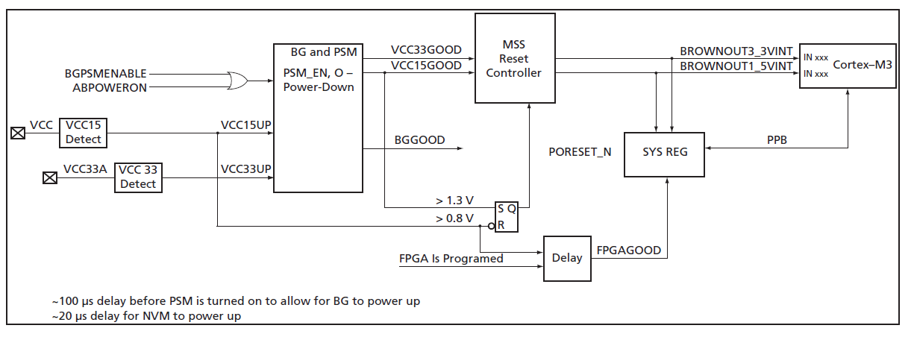
The Reset Interrupt
No power
System is held in RESET as long as VCC15 < 0.8V
  In reset: registers forced to default
  RC-Osc begins to oscillate
  MSS_CCC drives RC-Osc/4 into FCLK
  PORESET_N is held low
Once VCC15GOOD, PORESET_N goes high
  MSS reads from eNVM address 0x0 and 0x4

Slide 15
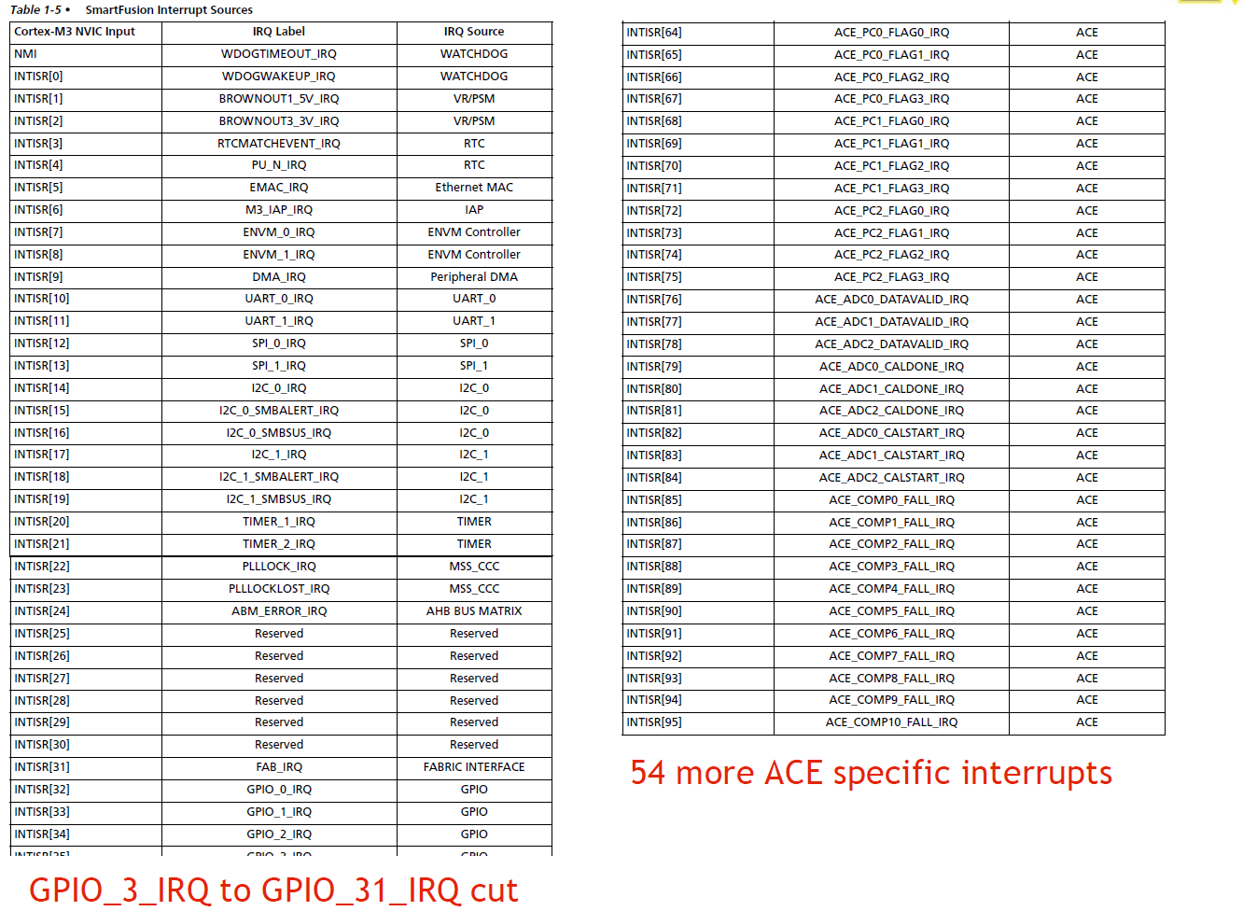

Slide 16
And the interrupt vectors
(in startup_a2fxxxm3.s found in CMSIS, startup_gcc)
g_pfnVectors:
.word _estack
.word Reset_Handler
.word NMI_Handler
.word HardFault_Handler
.word MemManage_Handler
.word BusFault_Handler
.word UsageFault_Handler
.word 0
.word 0
.word 0
.word 0
.word SVC_Handler
.word DebugMon_Handler
.word 0
.word PendSV_Handler
.word SysTick_Handler
.word WdogWakeup_IRQHandler
.word BrownOut_1_5V_IRQHandler
.word BrownOut_3_3V_IRQHandler
.............. (they continue)

Slide 17
Pending interrupts
The normal case. Once Interrupt request is seen, processor puts it in
“pending” state even if hardware drops the request.
IPS is cleared by the hardware once we jump to the ISR.

Slide 18
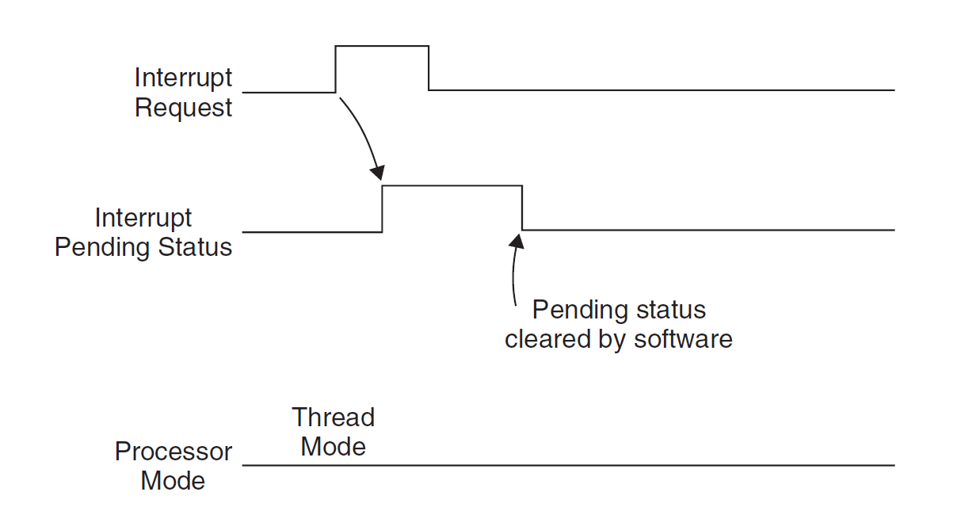
In this case, the processor never took the interrupt because we cleared the
IPS by hand (via a memory-mapped I/O register)

Slide 19
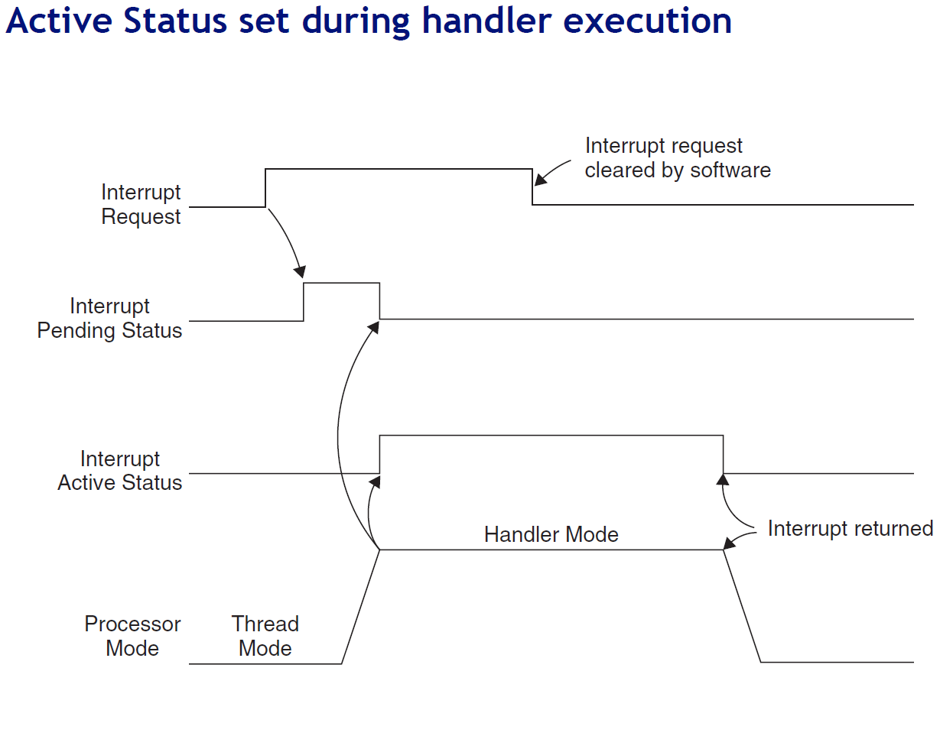

Slide 20
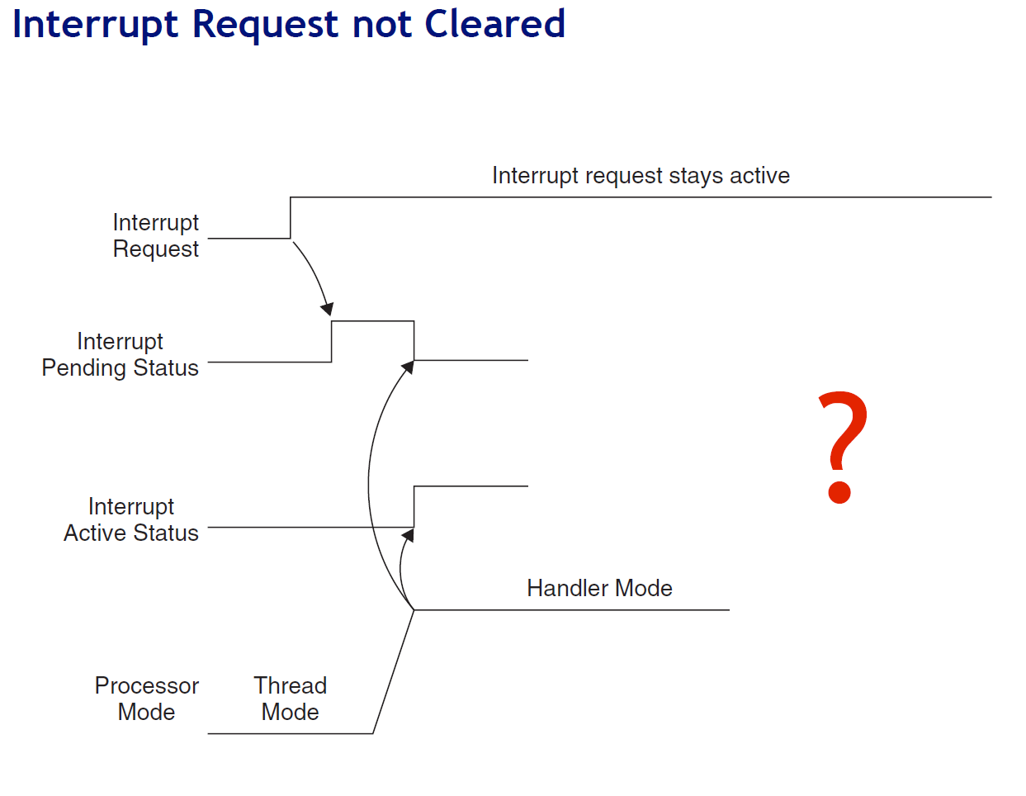

Slide 21
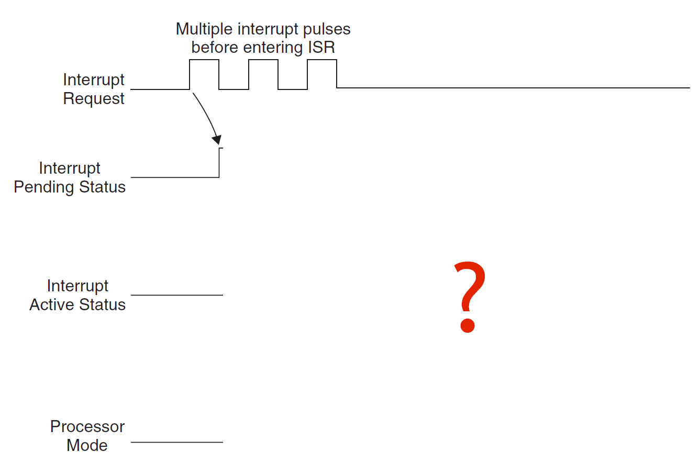

Slide 22
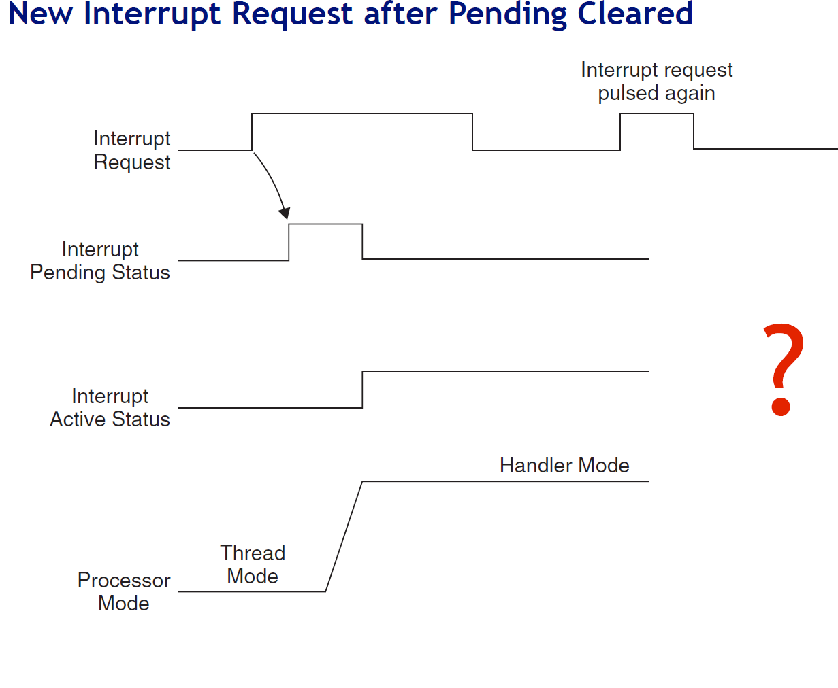

Slide 23
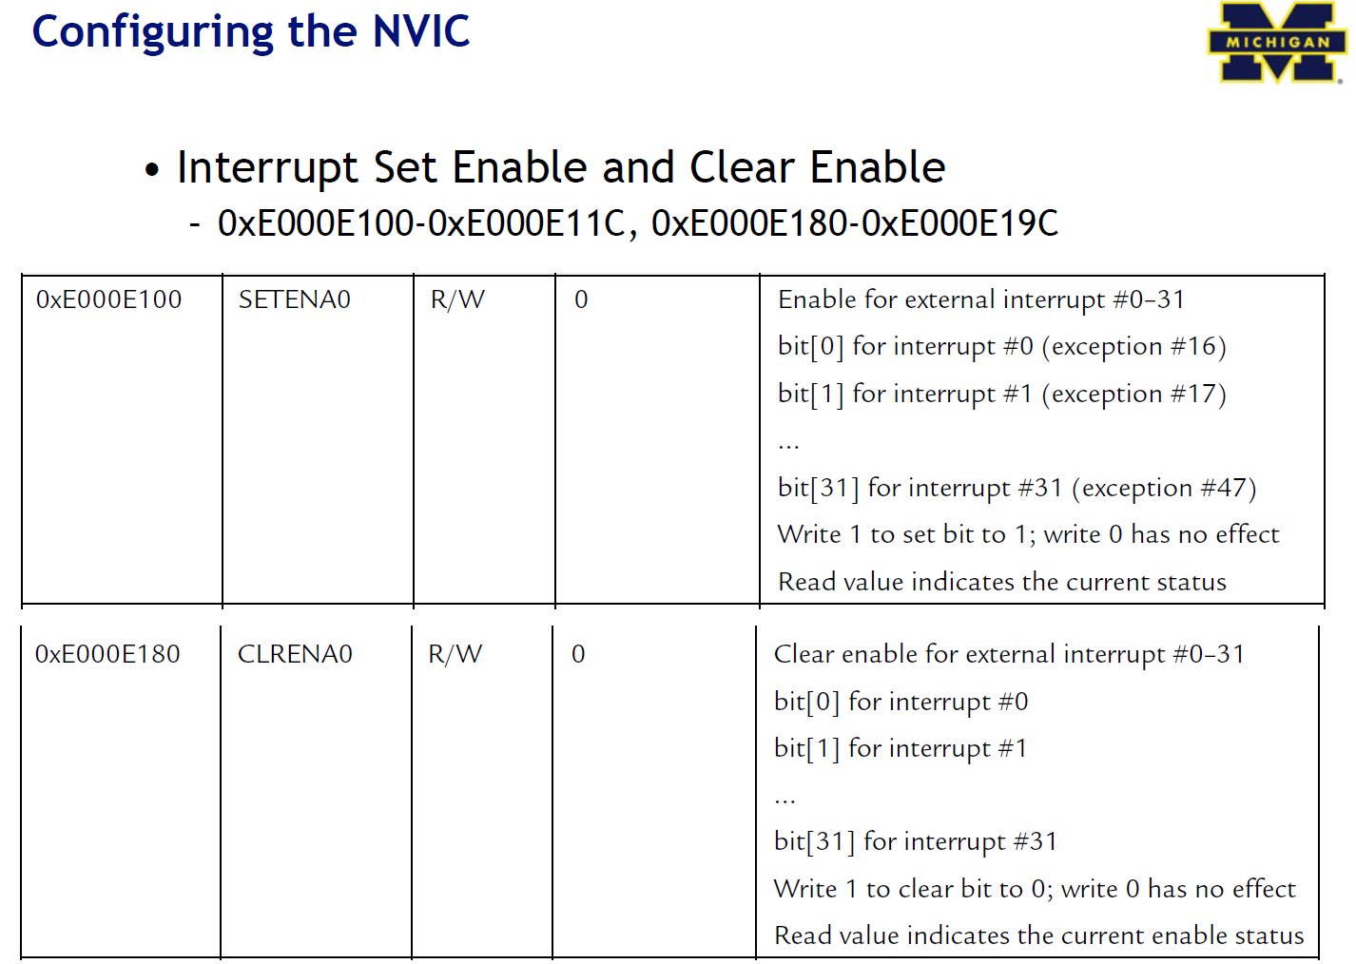

Slide 24
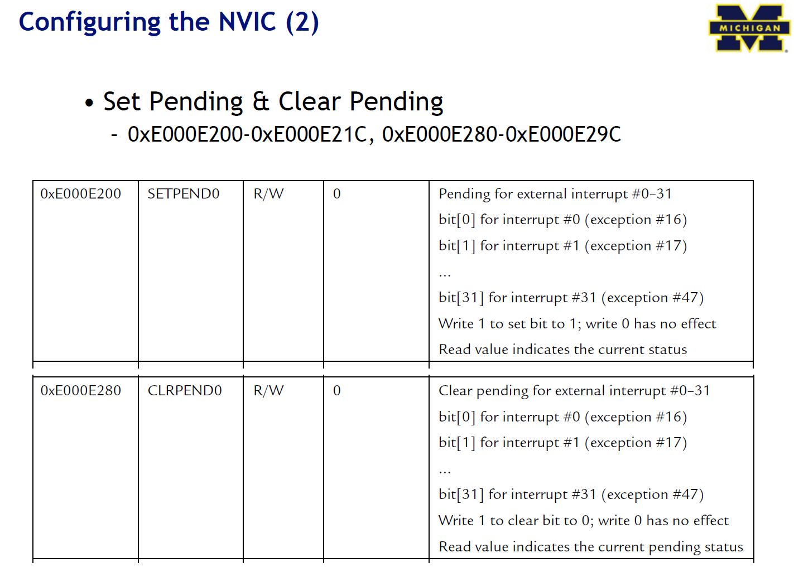

Slide 25
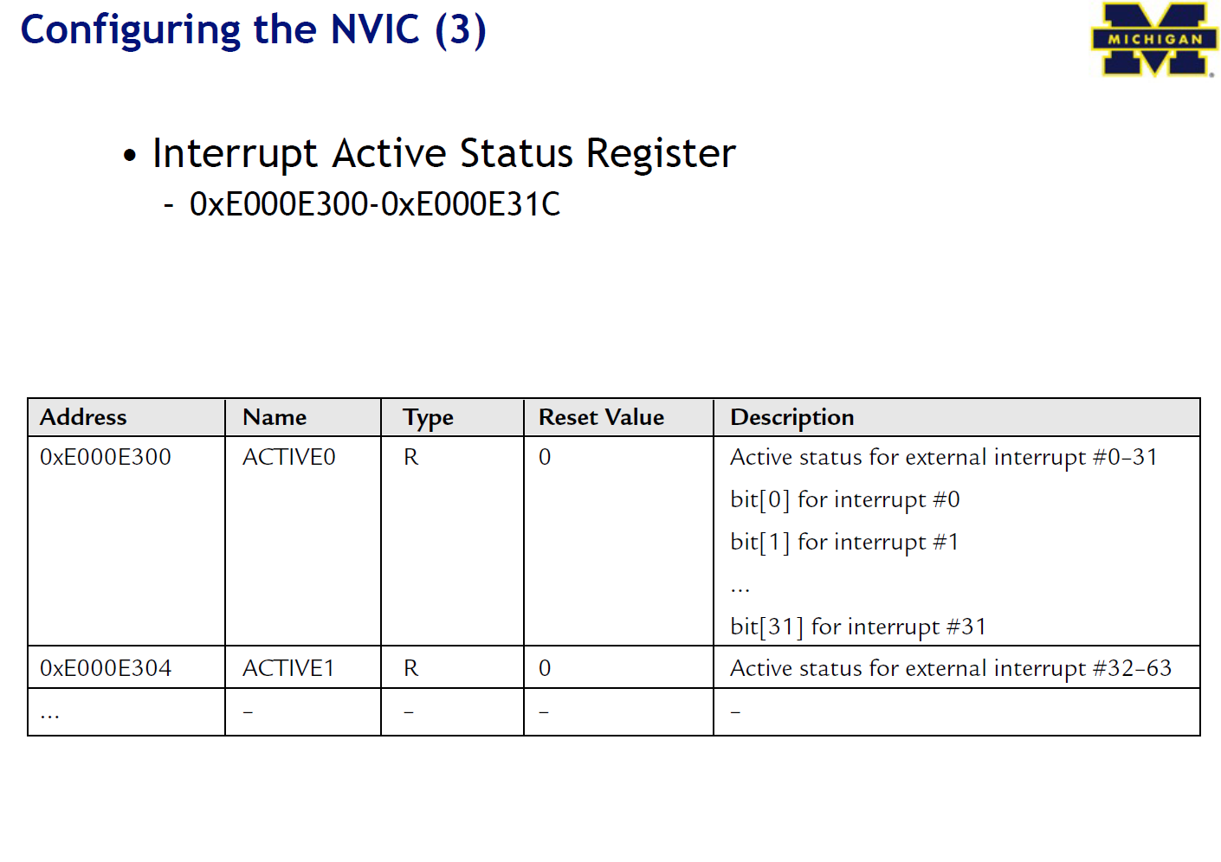

Slide 26
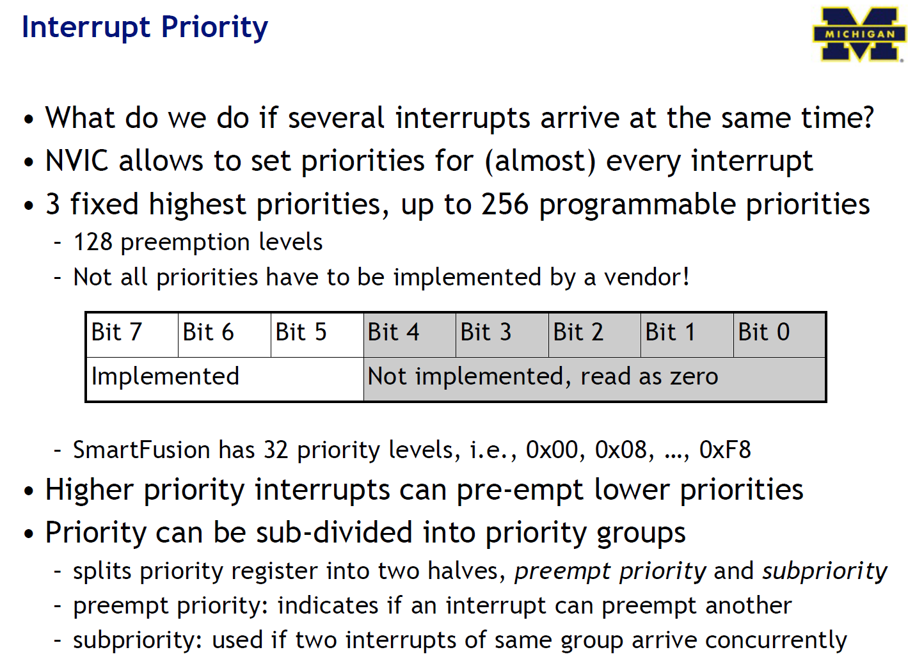

Slide 27
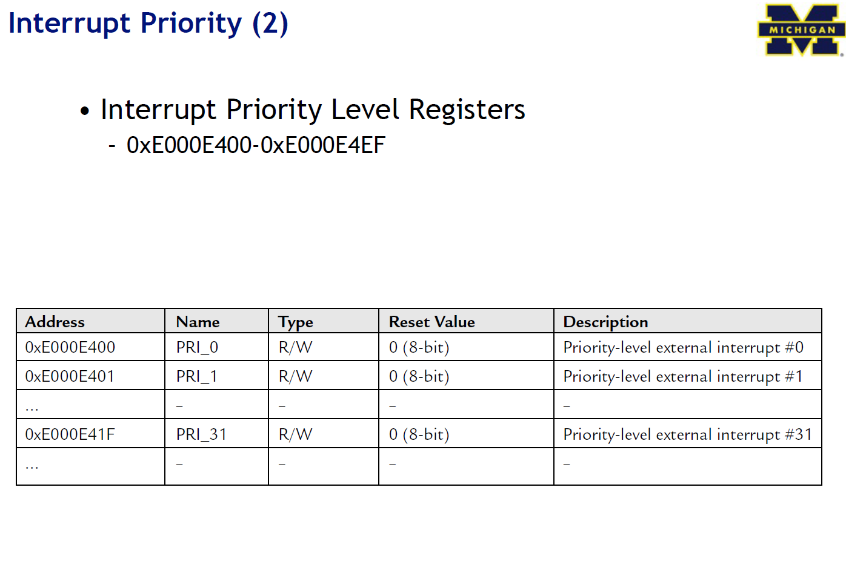

Slide 28
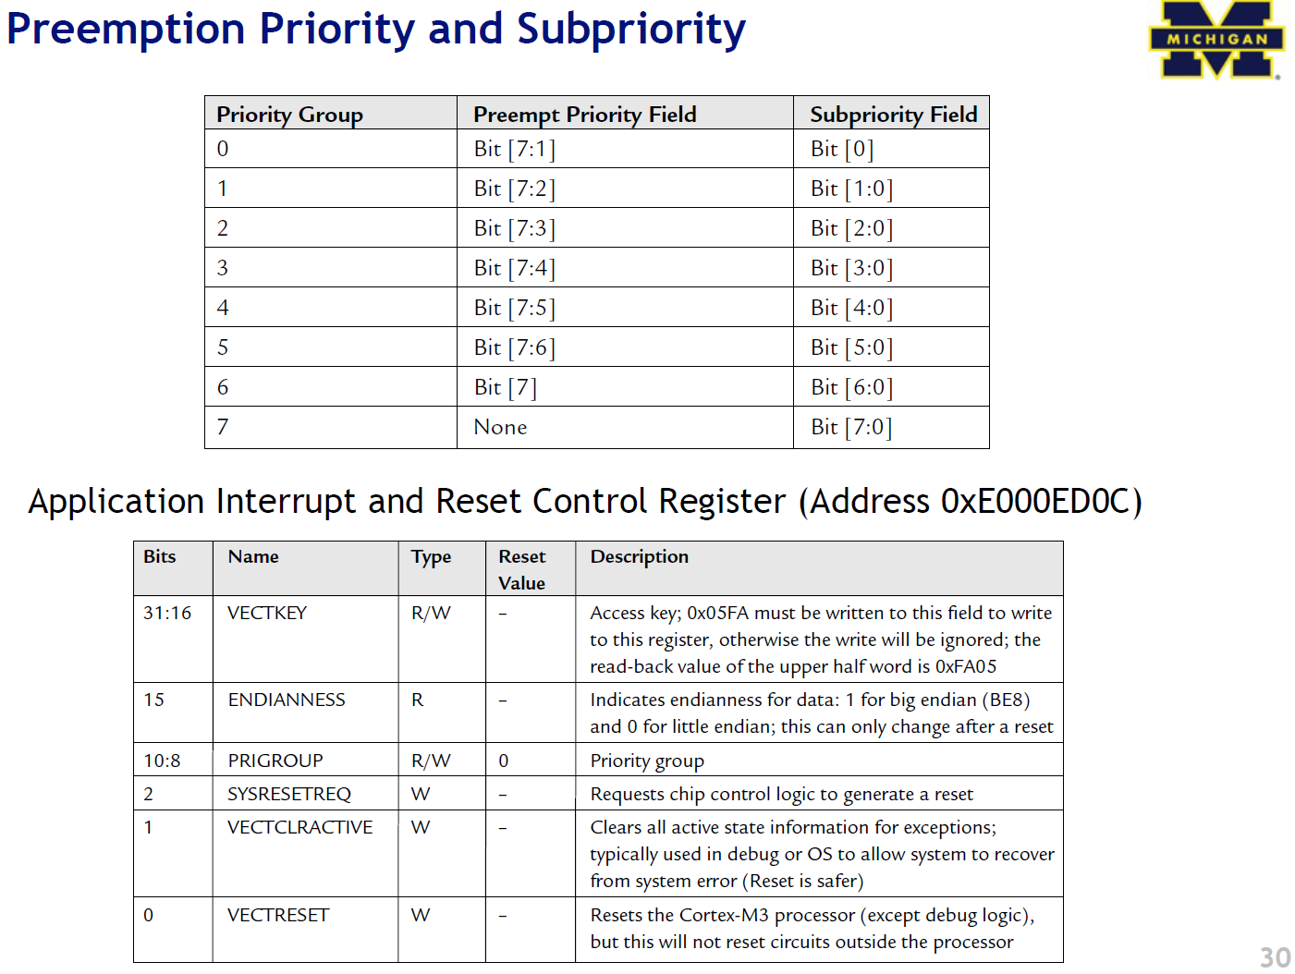

Slide 29
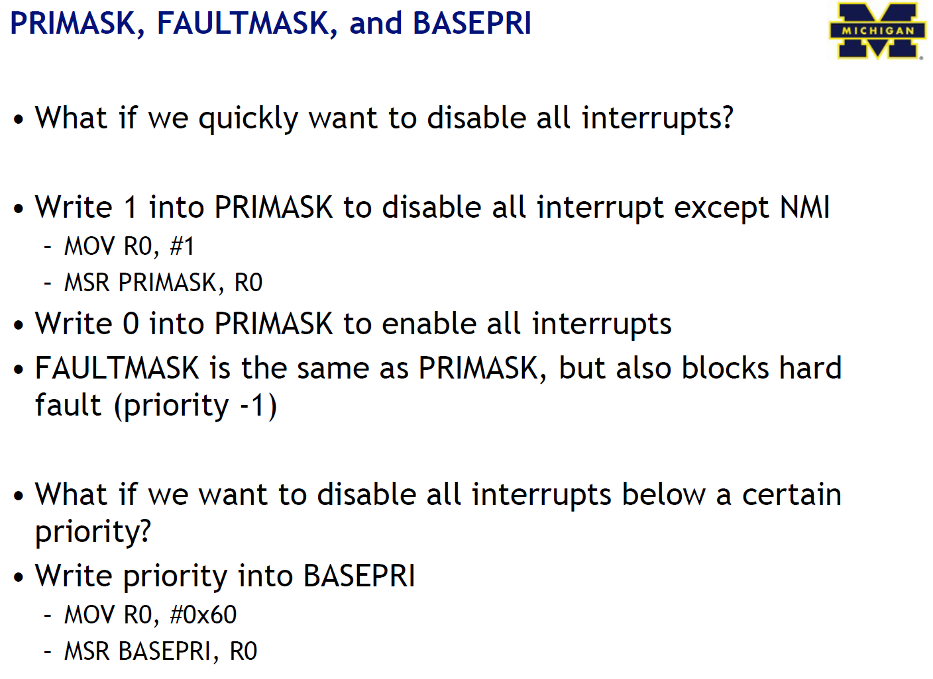

Slide 30
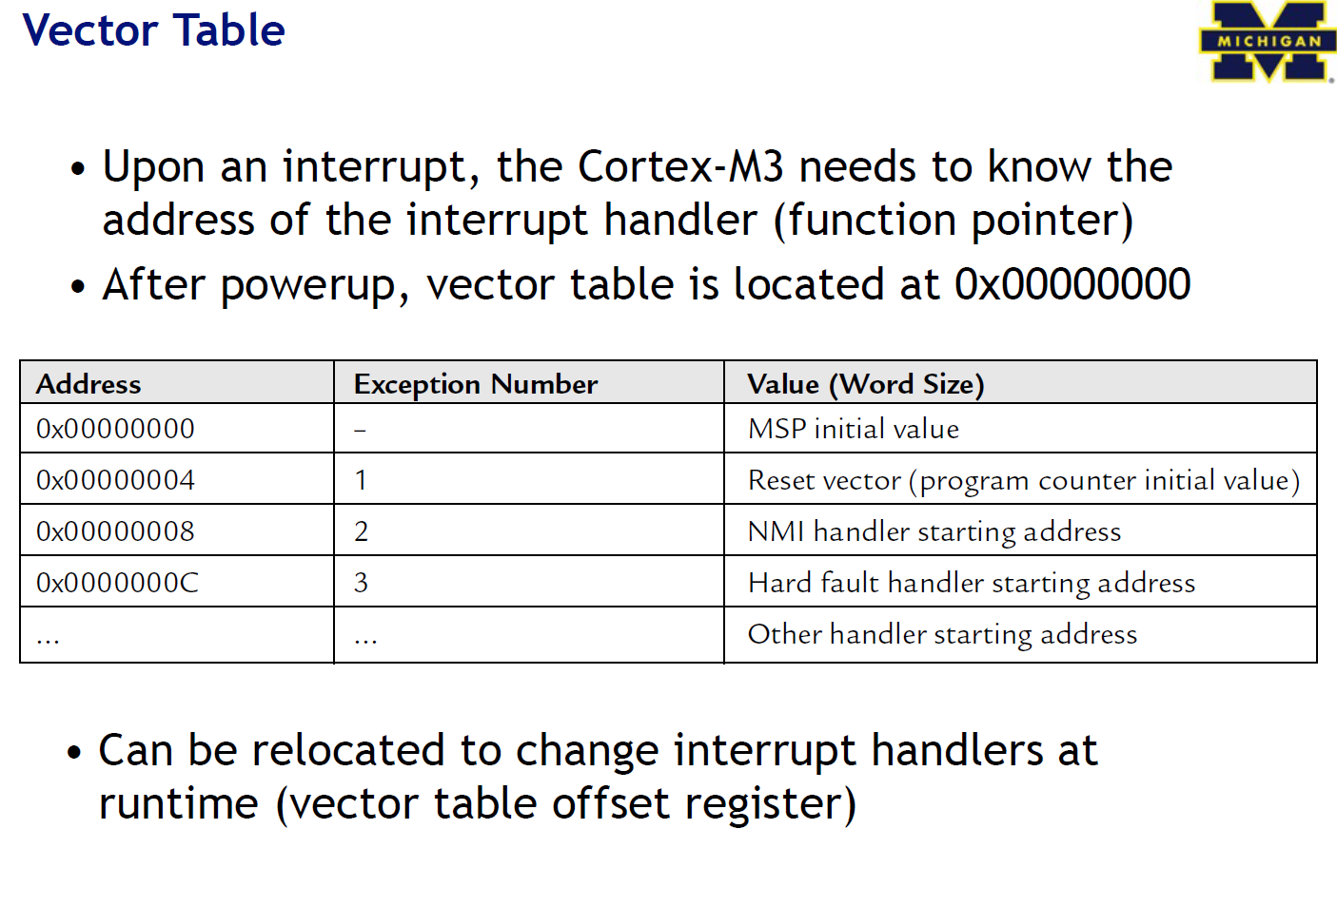

Slide 31
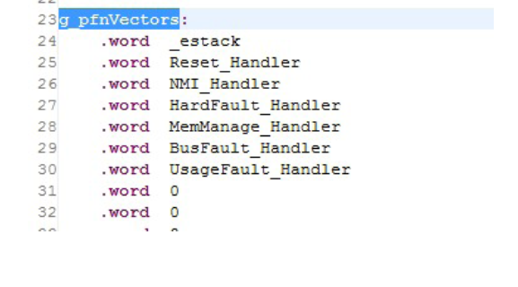
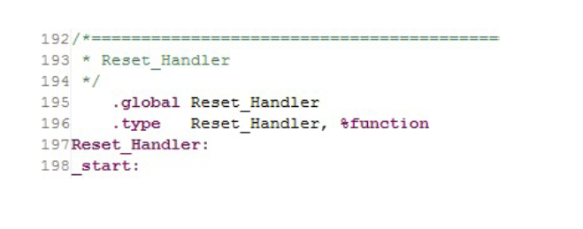
Interrupt handlers

Slide 32
